Slide 1
Strength Based Coaching: Transforming Conversations, Evoking Change!
NAEYC – November 2012
Susan MacDonald and Sara Miller

Slide 2
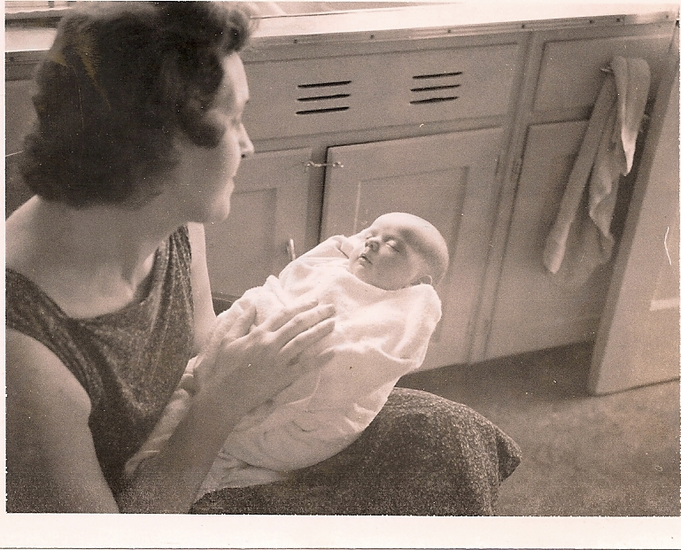
Notes:
What do you see? What do you wonder? What do you think? Key focus of Quality = Engagement, Being Present, Deeply Connecting to each other. Building Strength based relationships from our first interactions!

Slide 3

Conversations Matter
Notes:
Our Conversations – Our Questions Shape the world we live and work in. Positive affirming conversations help us to build strength based relationships that are foundation of our works as educators

Slide 4

Strength Based Focus
Increases Engagement
Creates Collaborative Teams
Improves Student Learning
Increases Productivity
Restores HOPE!

Slide 5
Meg Wheatley
“It takes courage to start a conversation. But if we don’t start talking to each other, nothing will change. Conversation is the way we discover how to transform our world, together.”

Slide 6

Traditional Deficit-Based Paradigm
Identifying Gaps Between Our Aspirations and Our Current Reality
Search for Root Causes
Generating Possible Solutions
Plan of Action
➲ Culprits

Slide 7

The Downside of Deficit-Based Change
Drains energy and fosters discouragement
Fosters a culture of blame and negativity
Squelches creativity and innovation
Weakens relationships and collaboration
Focuses on the past rather than generating positive images of the future
Notes:
Notes: Has anyone been part of a change process that had this impact? Share a few examples…

Slide 8

Albert Bandura
“It is far easier to discourage someone with our words than to encourage them.”
Notes:
What we are focusing on today is developing new ways to encourage and understanding the importance of using a strength based approach with teachers

Slide 9

Irving Borwick
“People don’t resist change; they resist being changed.”

Slide 10
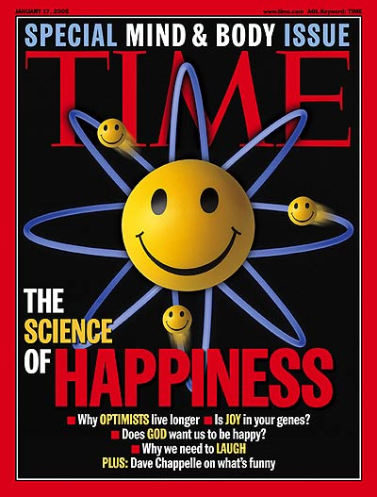
The Upside of Strengths-Based Change
Discovering and exploring strengths awakens curiosity, engagement, cooperation, and the alignment of organizational systems.
It is a better way
to change.
Notes:
Positive Psychology is a growing field of research that is documenting the tremendous impacts of focusing on strengths!

Slide 11

Transformational Paradigm
Celebrating Current Areas of Strength
Discovering Root Causes of Success
Envisioning New Possibilities
Innovating around What Brings Energy and Life

Slide 12
Core Assumptions of Appreciative Inquiry
What we focus on becomes our reality
Vitality is always there to be discovered
Asking questions influences those who answer; our questions are fateful
People increase their confidence for change when they build on what they know.

Slide 13

Appreciation Matters
“The sparkle of good feelings awakens motivation to change.”
~ Barbara Fredrickson

Slide 14
Why It’s Good To Feel Good
Positive
Actions & Outcomes
Positive Energy & Emotion
Positive Conversations & Interactions
Positive Questions & Reflections
Positive Anticipation of the Future
Positive Attention in the Present

Slide 15

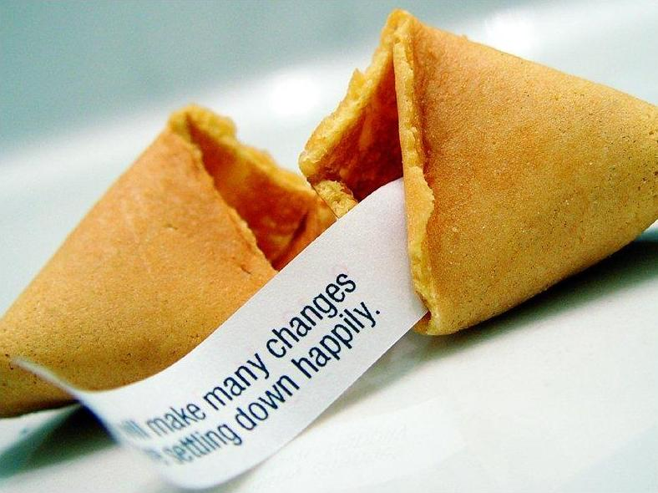

We Find What We Look For
Placebo Studies
Pygmalion Effect

Slide 16

Underlying Assumptions
Vitality is always there to be discovered
Our questions influence those who answer
The first question is fateful
People increase their confidence for change when they build on what they know

Slide 17

“By celebrating what’s right,
…we find the energy
to fix what’s wrong.

Slide 18

Conversations for Change
  “Calling forth
  motivation and movement in people,
  through conversation
  and a way of being,
  so they achieve
  desired outcomes
  and enhance their quality of life.”
Notes:
Talk about dancing with people in a strength based way – not dancing around them

Slide 19

Key Principles
Person-Centered
No-Fault
Strengths-Based

Slide 20
Person-Centered
Person
Awareness
Responsibility
Choice
Notes:
What do we put at the center a person, test score, initiative?

Slide 21

Carl Rogers
“The person-centered approach rests on a basic trust in human beings, and in all organisms, to flow toward the constructive fulfillment of their inherent possibilities.”

Slide 22

No-Fault
Nonjudgmental Stance
Mindful Listening
Expressing Empathy
Seeing the Beauty of the Needs

Slide 23

Meg Wheatley
“If you want to make change, host safe places for people to come together. Learning begins when people
feel safe enough
to take risks.”

Slide 24

Strengths-Based

Slide 25

Marcus Buckingham
“Excellence is not the opposite of failure. To learn about success
you have to study success.
Only successful examples
can tell you what excellence
looks like.”

Slide 26

Appreciative Inquiry
A strengths-based approach to learning and working
together that
enables people
to generate
change at the
speed of imagination

Slide 27

Albert Einstein
“We cannot solve our problems with the same thinking we used when we created them.”

Slide 28
Turning to Strengths
Initiate
“What is the focus?”
Aspiring, focusing
& framing
Clarifying
Inquire
“What gives life?”
Recognizing, valuing,
& celebrating
Appreciating
Imagine
“What might be?”
Dreaming, dialoguing, & choosing
Envisioning
Positive
Core

Slide 29

Traditional SWOT
Strengths
Opportunities
Weaknesses
Threats

Slide 30

Transformational SOAP
Strengths
Observations
Aspirations
Possibilities

Slide 31


Reframing the Focus of Attention
Deficit Issues
Affirmative Topics
Highly Engaged & Motivated
Extraordinary Collaboration
High Engagement & Learning
Exceptional Professional Learning
Longevity
Stress & Low Morale
Isolation
Low Achievement
Irrelevant Professional Development
Employee Turnover

Slide 32
The Snoopervisor ~
Anonymous 1929
With keenly peering eyes and snooping nose, From room to room the Snoopervisor goes
He notes each slip each fault with lofty frown. And on his rating card, he writes it down; His duty done when he has brought to light, The things that teachers do that are not right.
The supervisor enters quietly, “What do you need? How can I help today? John, let me show you. Mary try this way.” She aims to help, encourage and suggest, That the teachers, pupils may do their best.
,

Slide 33

Shifting Perspective
Notes:
As you can imagine, with all that data collection, through all those conversations, with all those work sessions, we’ve heard a lot of different perspectives. Some have been more positive, others more negative, and some have flat out contradicted each other. But that doesn’t make any of them wrong.
Look at this picture. What do you see? What’s right? We’re both right! And so it is with persepe
ctive.

Slide 34
Shifting Perspective
Notes:
As you can imagine, with all that data collection, through all those conversations, with all those work sessions, we’ve heard a lot of different perspectives. Some have been more positive, others more negative, and some have flat out contradicted each other. But that doesn’t make any of them wrong.
Look at this picture. What do you see? What’s right? We’re both right! And so it is with persepctive.

Slide 35
LISTEN - Ralph Roughton, M.D.
When I ask you to listen to me and you start giving advice, you have not done what I asked. When I ask you to listen to me and you begin to tell me why I shouldn’t feel that way, you are trampling on my feelings.
When I ask you to listen to me and you feel you have to do something to solve my problems you have Failed me, strange as that may seem. Listen, all I asked was that you listen – not talk or do, just hear me.
When you do something for me that I can and need to do for myself, you contribute to my fear and inadequacy.
But when you accept as a simple fact that I do feel what I feel, no matter how irrational, then I can quit trying to convince you and can get about the business of understanding what’s behind this irrational feeling.
And when that’s clear, the answers are obvious and I don’t need advice. Irrational feelings make sense, when we understand what’s behind them. Perhaps that’s why prayer works, sometimes, for some people– because God is mute and He/She doesn’t give advice or try to fix things. So please listen and just hear me. And if you want to talk, wait a minute for your turn, and I’ll listen to you. –

Slide 36

Paired Interviews
Share a “high-point” moment from the past 6 – 12 months. What was the situation? What happened that made you aware of your strengths?
Share the three best qualities that the people close to you would share if they were asked about you?
Choose one of your strengths and remember a time when you lived up to that strength? What happened? How did working to that strength impact your perception of time, productivity and work satisfaction?
How will you continue to develop your strengths? What possibilities can you imagine when you amplify your strengths?
What excites you about using this strength based approach with teachers?

Slide 37
Diving into Strengths
Initiate
“What is the focus?”
Aspiring, focusing
& framing
Clarifying
Inquire
“What gives life?”
Noticing, valuing
& understanding
Appreciating
Imagine
“What might be?”
Dreaming, dialoguing, & choosing
Envisioning
Positive
Core

Slide 38

Generates New Possibilities
The more we know about our strengths, the better our changes will be.

Slide 39
Learning from Strengths
Fairness
Creativity
Love of Learning
Curiosity
Hope
Appreciation of Beauty
Love
Forgiveness
Prudence
Open-Mindedness
Self-Regulation
Leadership
Modesty
Zest
Teamwork
Social Intelligence
Bravery
Honesty & Authenticity
Kindness
Humor
Gratitude
Perseverance
Spirituality / Religiousness
Perspective

Slide 40

Learning from Self-Observation

Slide 41
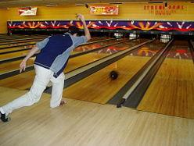
Learning from Success
Neurons became more “finely tuned” in the wake of success whereas “failure generated virtually no change in neural processing at all.”

Slide 42

Marilee Adams
“A world of questions is a world of possibility.
We have only to ask the right questions to begin.”

Slide 43

Asking Strengths-Based Questions
Best Experiences
Core Values
Supporting Conditions
Three Wishes

Slide 44

Antoine de Saint Exupery
“If you want to build a ship, don’t drum up people to gather wood, give orders, and divide the work.
Instead, teach them to
yearn for the vast and
endless sea.”

Slide 45
Amplifying Strengths
Initiate
“What is the focus?”
Aspiring, focusing
& framing
Clarifying
Inquire
“What gives life?”
Noticing, valuing
& understanding
Appreciating
Imagine
“What might be?”
Visualizing, expressing & brainstorming
Envisioning
Positive
Core

Slide 46


Positive Images  Positive Actions
Heliotropic Principle
Emotional Resonance
Affirmative Cognition
  Self-Efficacy
  Collective-Efficacy
Reinforcing Cycle

Slide 47
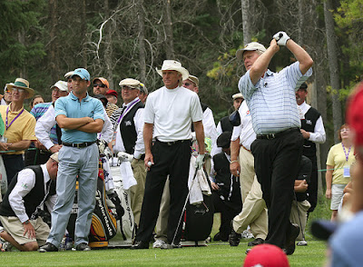
Jack Nicklaus
“I’m going to hit it right down the middle of the fairway.”

Slide 48

Tames the Frenzy

Slide 49

Images that Inspire Action
Grounded
Provocative
Desired
Proleptic
Participatory

Slide 50

Cultivates Positive Relationships
Builds Trust
Communicates confidence
Shifts conversations
Reveals silver linings
Gets people into flow

Slide 51
Engineering the Experience
Initiate
“What is the focus?”
Aspiring, focusing
& framing
Clarifying
Inquire
“What gives life?”
Noticing, valuing
& understanding
Appreciating
Imagine
“What might be?”
Visualizing, expressing & brainstorming
Envisioning
Innovate
“What will be?”
Choosing, prototyping & engineering
Co-Constructing
Positive
Core

Slide 52

Design Thinking Formula
INNOVATION =
INSPIRATION +
IDEATION +
IMPLEMENTATION

Slide 53

Coaching with Strengths
Brainstorming possibilities
Prototyping solutions
Orchestrating quick wins
Reframing setbacks
Repeating success

Slide 54

Generates Demonstrable Gains
A strengths-based focus on development has been shown to increase:
Employee Engagement
Student Learning
Attendance
Productivity
Hope

Slide 55

Tim Brown
“You need to be optimistic in order to be creative. And confident. In fact, if you don’t have confidence that you can create solutions, you won’t create solutions.”

Slide 56
INSPIRATIONS
FOR BRINGING STRENGTH BASED COACHING TO YOUR DAILY WORK!

Slide 57
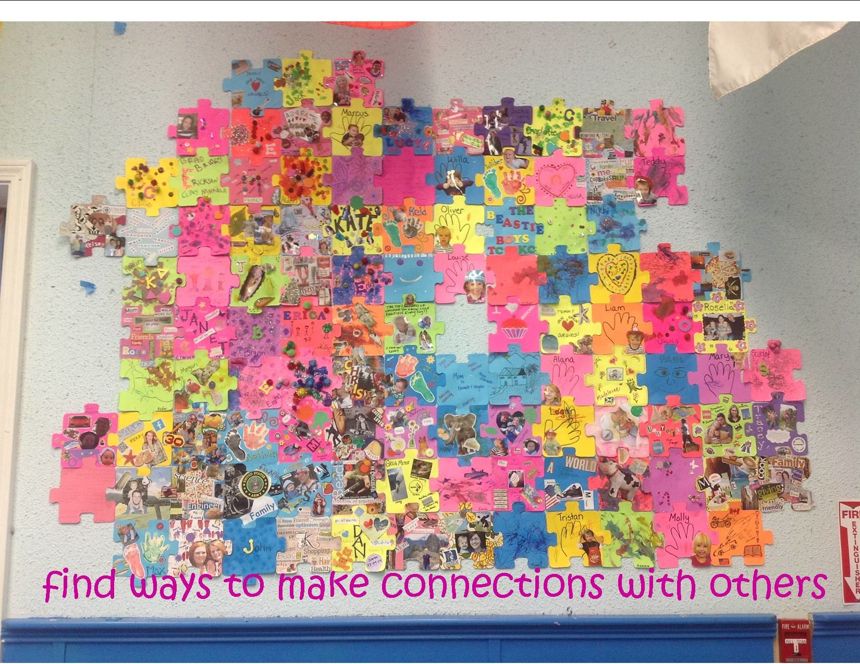

Slide 58

www.SchoolTransformation.com

Slide 59


